Slide 1
Basic Computer Organization
Instructor: Saba Iqbal

Slide 2
Learning Objectives
Parts of Computer System
Basic operations of Computer System
Basic organization of Computer System

Slide 3
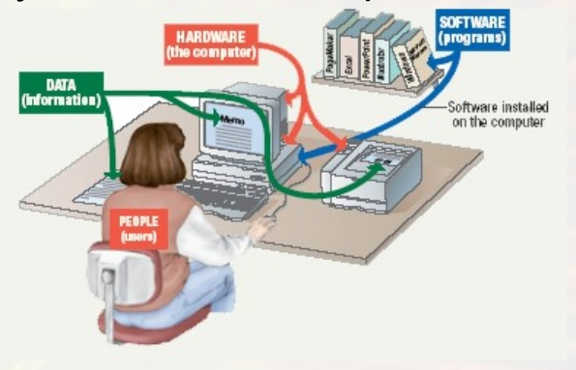
Parts of Computer System
A complete computer system consists of four parts
Hardware
Software
Data
User

Slide 4
Parts of Computer System
Hardware
Consists of electronic circuits and mechanical devices used to perform various functions
Physical part of computer system
Used to control computer operations (i.e. Input and Output)
For example hardware components are: CPU, memory unit, keyboard, mouse, monitor, printer, disk drivers etc.
Software
Set of instructions that tell the computer what to do
Also called a program

Slide 5
Parts of Computer System
Data
Consist of individual facts or pieces of information
Converting them into useful information
Users
People operating the computer
Most important part
Tell the computer what to do

Slide 6
Basic Operations of Computer System
Inputting:
The process of entering data and instructions into the computer system.
Storing:
Saving data and instructions to make them readily available for initial and additional processing whenever required.
Processing:
Performing arithmetic operations (add, subtract, multiply, divide, etc.) or logical operations (comparisons like equal to, less tan, greater than etc.) on data to convert them into useful information.

Slide 7
Basic Operations of Computer System
Outputting:
The process of producing useful information or results for the user such as a printed report or visual display
Controlling:
Directing the manner and sequence in which all of the above operations are performed.

Slide 8
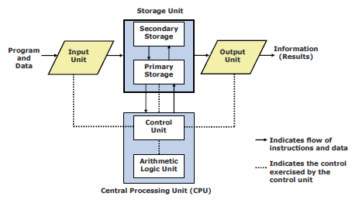
Basic organization of a Computer System

Slide 9
Basic organization of a Computer System
Input Unit
An input unit of a computer system performs the following functions:
It accepts ( or reads) instructions and data from outside world.
It converts these instructions and data in computer acceptable form
It supplies the converted instruction and data to the computer system for further processing

Slide 10
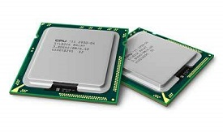
Basic organization of a Computer System
Central Processing Unit (CPU)
It is the brain of a computer system
It is responsible for controlling the operations of all other units of a computer system
It consists of two main components:
Control Unit (CU)
ALU(Arithmetic Logic Unit)

Slide 11
Control Unit (CU)
Control Unit of a computer system manage and coordinates the operations of all other components of the computer system
Functions of this unit are
It is responsible for controlling the transfer of data and instructions among other units of a computer.
It manages and coordinates all the units of the computer.
It obtains the instructions from the memory, interprets them, and directs the operation of the computer.
It communicates with Input/Output devices for transfer of data or results from storage.
It does not process or store data.

Slide 12
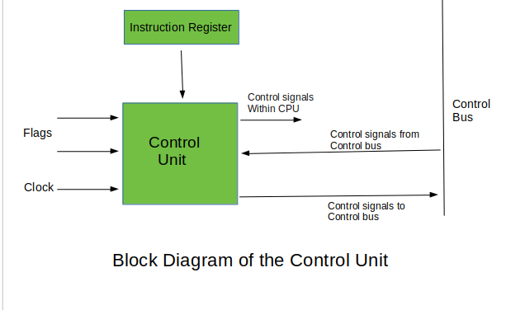
Control Unit (CU)

Slide 13
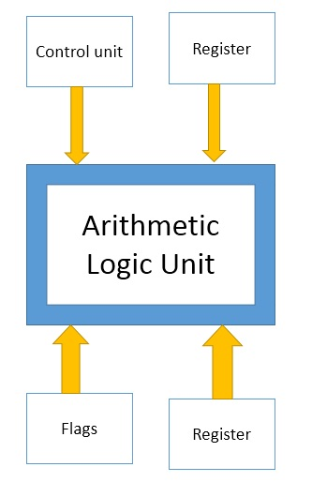
ALU (Arithmetic Logic Unit)
Arithmetic logic unit of a computer system is the place where the actual executions of instructions takes place during processing operation
This unit consists of two subsections namely,
Arithmetic Section
Logic Section

Slide 14
ALU (Arithmetic Logic Unit)
Arithmetic Section
Function of arithmetic section is to perform arithmetic operations like addition, subtraction, multiplication, and division.
All complex operations are done by making repetitive use of the above operations.
Logic Section
Function of logic section is to perform logic operations such as comparing, selecting, matching, and merging of data.

Slide 15
Basic organization of a Computer System
Output Unit
An output unit of a computer system performs the following functions:
It accepts the results produced by the computer, which are in encoded form and hence, cannot be easily understood by us
It converts these coded results to human acceptable (readable) form
It supplies the converted results to outside world

Slide 16
Basic organization of a Computer System
Storage/ Memory Unit
Storage unit of a computer system holds (or store) the following:
Data and instructions required for processing( received from input devices)
Intermediate result of processing
Final result of processing, before they are released to an output device

Slide 17
Types of Storage
Primary Storage
Secondary Storage

Slide 18
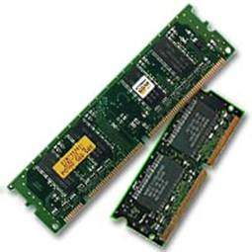
Primary Storage
Primary memory holds only those data and instructions on which the computer is currently working.
It has a limited capacity and data is lost when power is switched off.
It is a volatile memory.
It is generally made up of semiconductor device.
The data and instruction required to be processed resides in the main memory.
It is divided into two subcategories RAM and ROM.

Slide 19
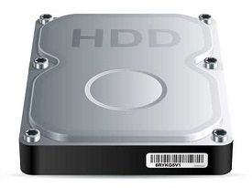
Secondary Storage
This type of memory is also known as external memory or
non-volatile.
It is slower than the main memory.
These are used for storing data/information permanently.
CPU directly does not access these memories, instead they are accessed via input-output routines.
The contents of secondary memories are first transferred to the main memory, and then the CPU can access it. For example, disk, CD-ROM, DVD, etc.

Slide 20
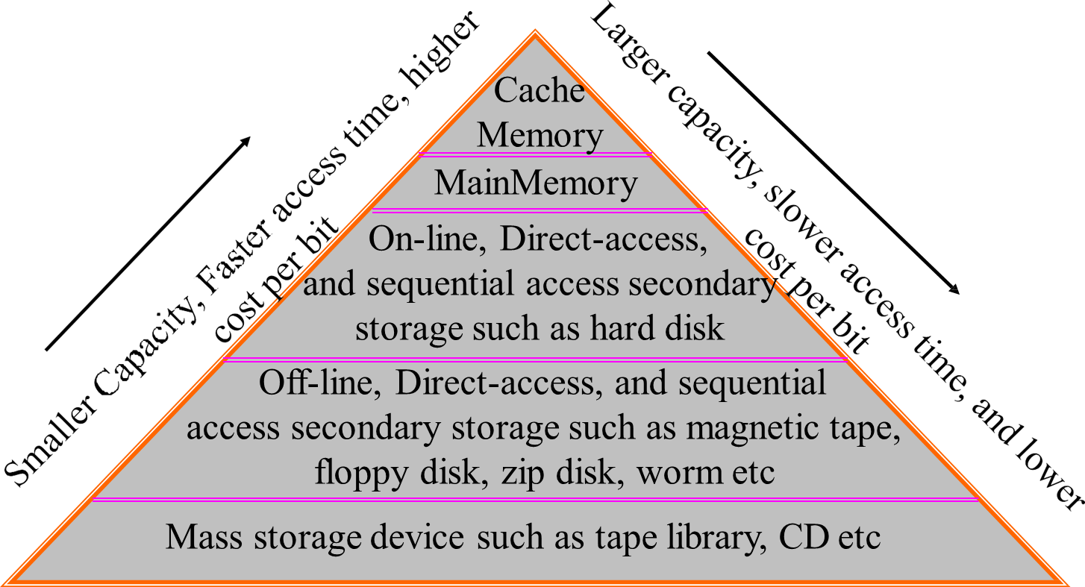
Memory Hierarchy

Slide 21
Q\A

